Slide 1
Python for finance
Lab 3.

Slide 2
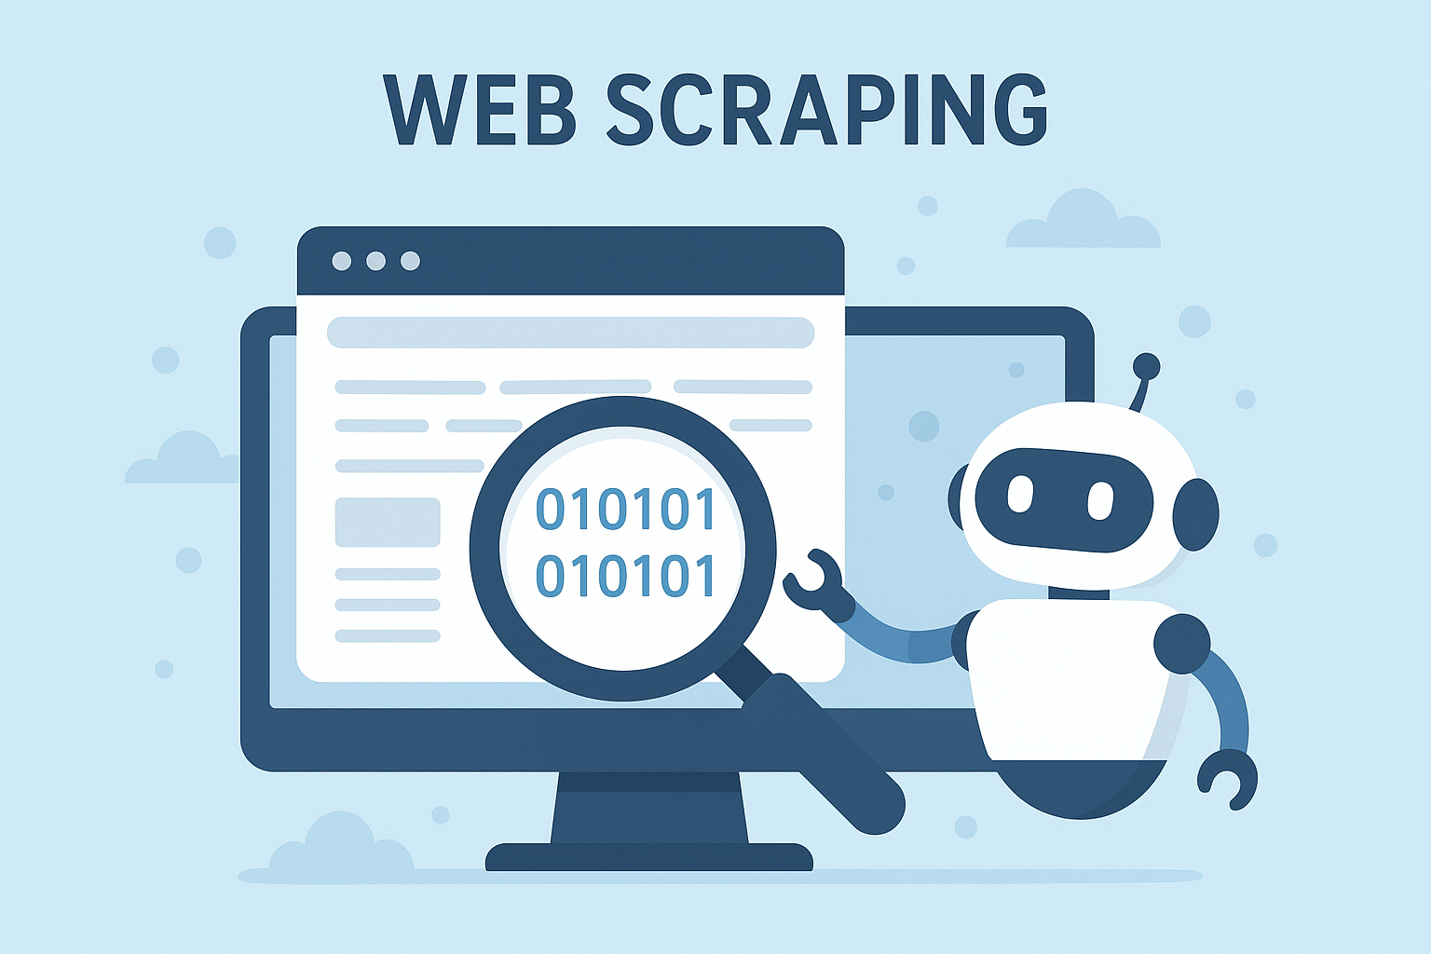
Web scraping
AI generated image using keywords : web scraping

Slide 3
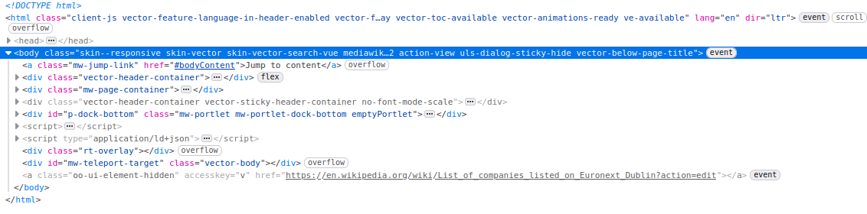
HTML
Hyper Text Markup Language
Extension of XML
Organized with tags ‘<>’
each tag has a name, for example : <body>
A tag is close with ‘/’, for example : </body>

Slide 4
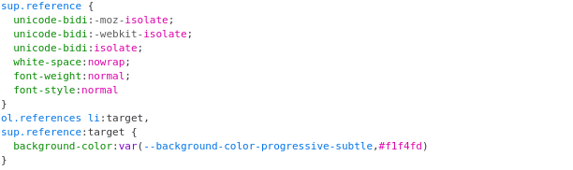
CSS
Cascade Style Sheets :
Used to specify the style and presentation
Can be slightly dynamic:
Changing colors upon actions
adapts to size of the screen or window

Slide 5
Javascript
Programming language for client-side
Reads requests and executes them:
Retrieving the correct HTML code and display it
Ask for some action from user
…
Has nothing to do with Java
Javascript was created by Netscape
Java was created by Sun Microsystems

Slide 6
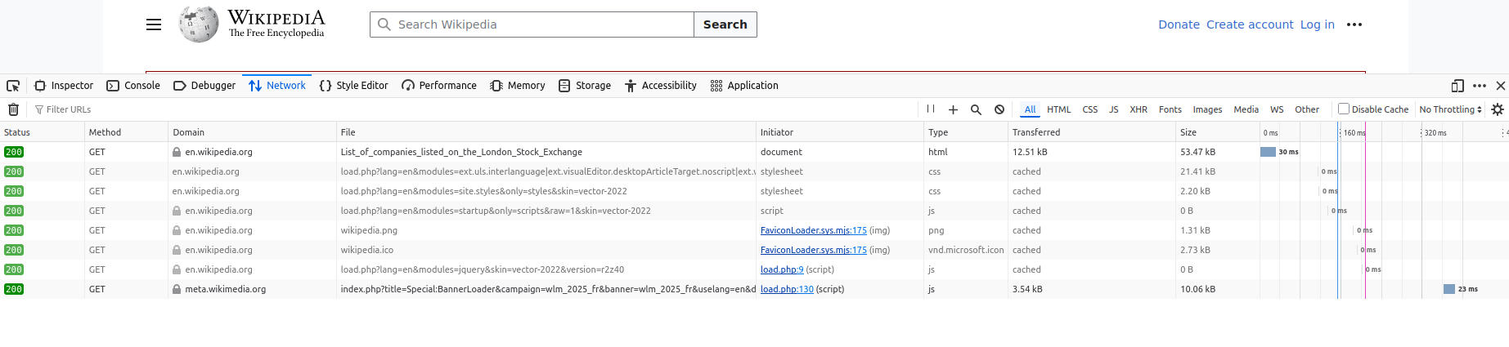
Web developer tools
These tools are available on any browser and are very useful for web scraping
By examining the HTML code and network requests, you can figure out how to fetch data.

Slide 7
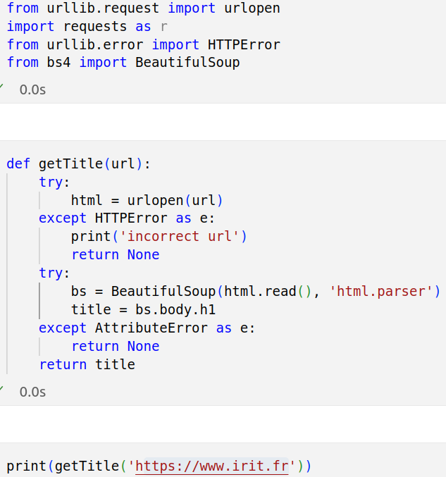
Beautiful soup
Python library for web scraping

Slide 8
Problem : it is hard to know what is legal
Trespass to chattels:
Lack of consent (Terms of service)
Actual harm
Nowadays computers are so powerfull that you could easily take down a server
Intentionality
You wrote the code, it is hard to believe that you didn’t intent to
The computer fraud and abuse act
See the case of Aaron Swartz ‘The internet’s own boy’
Always obtain permission
Respect terms of service
Consider both legal and ethical implications before scraping any data

Slide 9
Solution : use APIs instead
Yahoo Finance
Not official, developed by a single person
Easy to handle, enough to just download stocks
Alpha Vantage
Free plan for basic usage
Well-documented
Reliable

